Slide 1
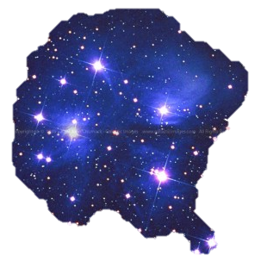
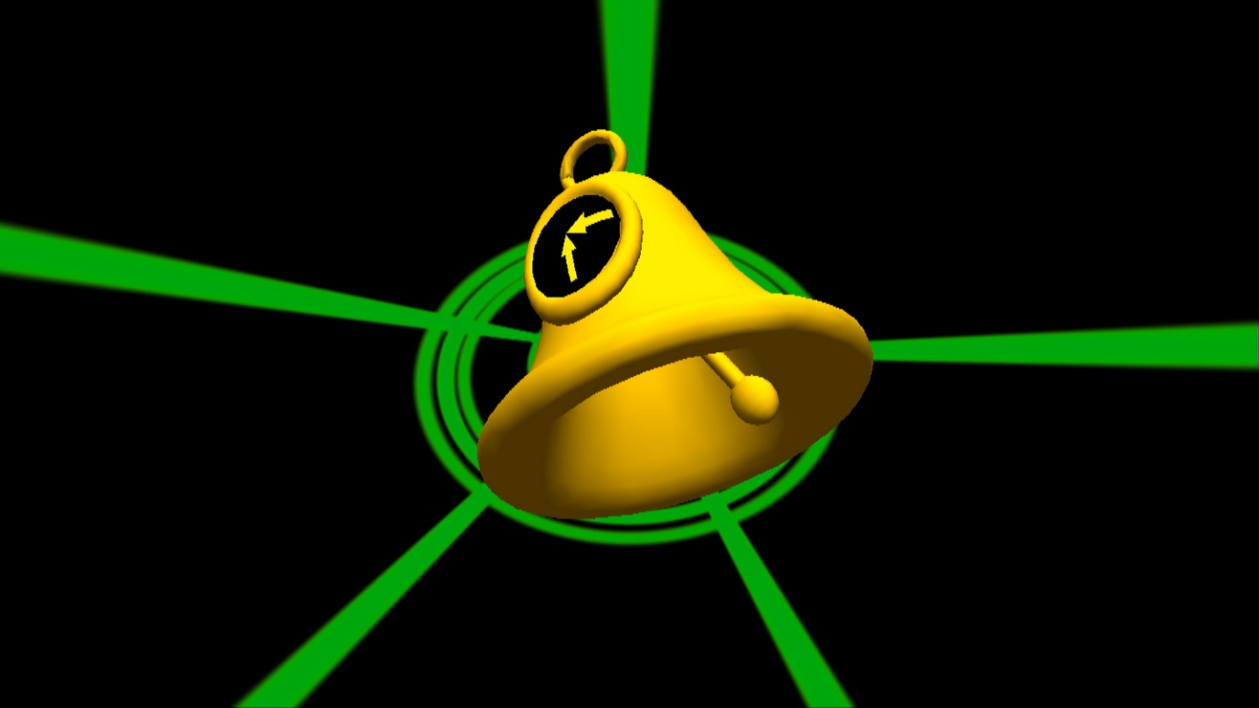

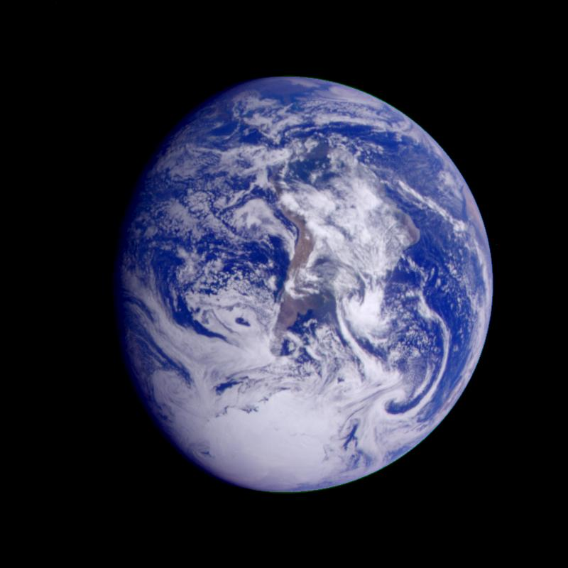
Our fascination with Big Questions about the universe around us – and our place within it…

Slide 2
How observations help astronomers to discover whether there is water on Mars… and … How astronomers work with experts in other disciplines to address more complex questions about living on Mars

Slide 3
Teacher Notes
1. Recognising the Role of Observation in Science – and the limitations of science enquiry.
Objective: Children can explain that observation is central to scientific inquiry and that science can directly answer questions that suit its methods.
Role of teacher: give children a practical hand-on activity in the classroom to experience for themselves “thinking like a scientist” and making observations. For example – chromatography as it is very visual.
Share with children a PowerPoint that explains three ways scientists observe Mars - (telescopes, rovers, orbiters).
Role of the interactive - emphasises that observation is at the heart of science and that that scientists are fundamentally observers of the natural world – this means that scientists can directly answer the question “Which planet is hotter, Earth or Mars?” and “Does Mars have liquid water on its surface,
Indicators of Success: Children
Can explain that observation is the ‘most important’ word when we think like a scientist.
Can explain three ways that scientists observe Mars (telescopes, rovers, orbiters).
Can explain that using observations, scientists can tell us whether Mars has liquid water on its surface.

Slide 4
How ‘observing like a scientist’ us discover whether there’s water on Mars
In this PowerPoint exploration, we learn how astronomers use observations to discover what it’s like on Mars.
At the end of the session, you should understand – how astronomers gather observations of Mars to discover whether Mars has water
The session will end with a discussion about what types of questions about Mars we can answer scientifically – and what questions cannot be answered by science alone.

Slide 5
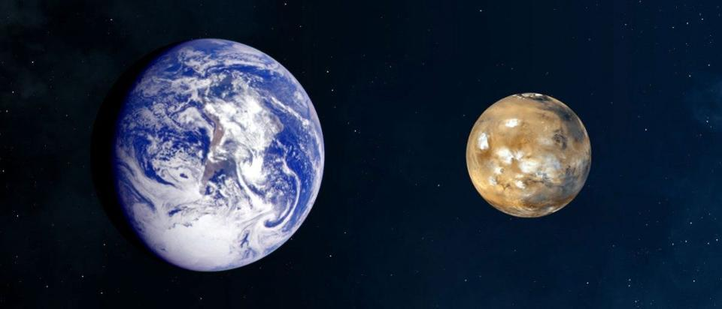
Comparing images of Mars and Earth:
what do you observe?

Slide 6
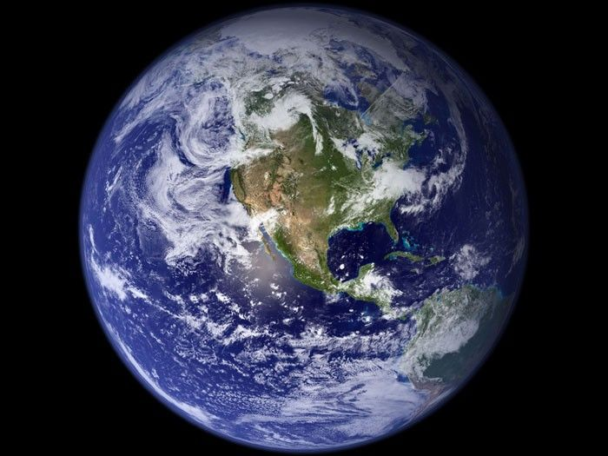
Earth is sometimes called the blue marble…
From space, Earth looks like a blue marble – satellites orbiting the earth capture its ‘blue’ oceans, brown continents and white swirly clouds.
We know why too. Did you know, 70% (over half) of the Earth’s surface is covered by water. Earth’s gravitational field means it can hold an atmosphere – and clouds.

Slide 7
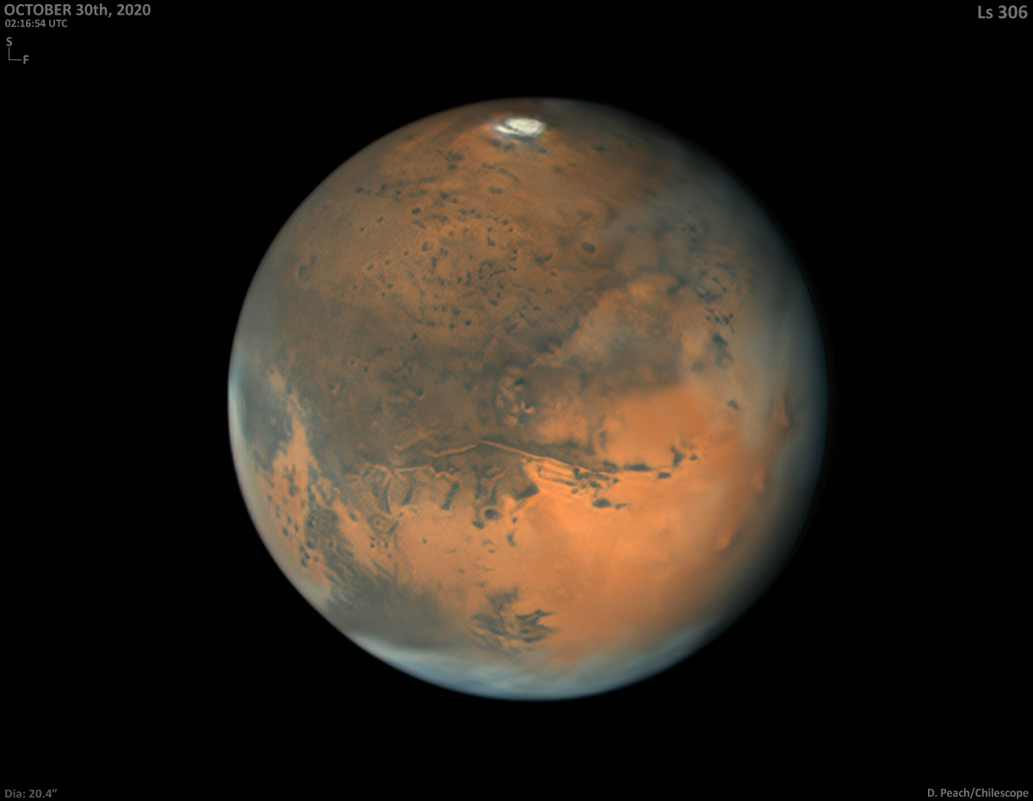
Mars – smaller and the ‘red planet’
We can observe that Mars is smaller than the Earth
And we observe that it is redder.
We hypothesise that there is less liquid water on Mars – or even none at all. How do we find out if we are right?

Slide 8
Science – including Astronomy
When we think like a scientist – we are thinking about the natural world and using observations to get and test ideas.
Observation is at the heart of science – it matters more than experiments
And in astronomy – it’s ALL about observing – we don’t do experiments.

Slide 9
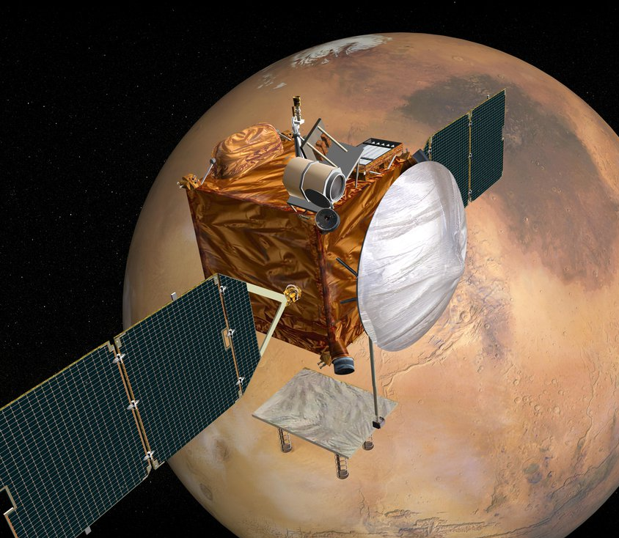
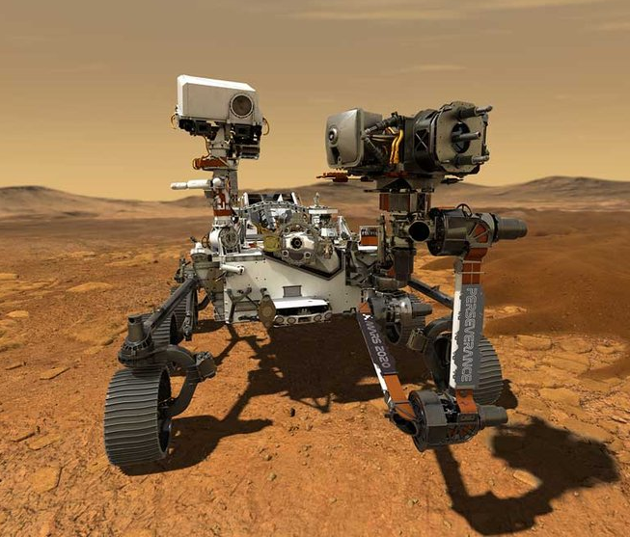
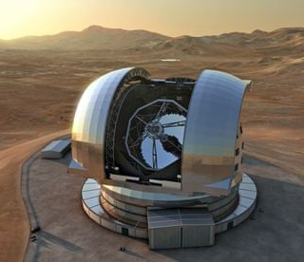
Three ways to observe Mars
Orbiter
Rover
Telescope on Earth

Slide 10
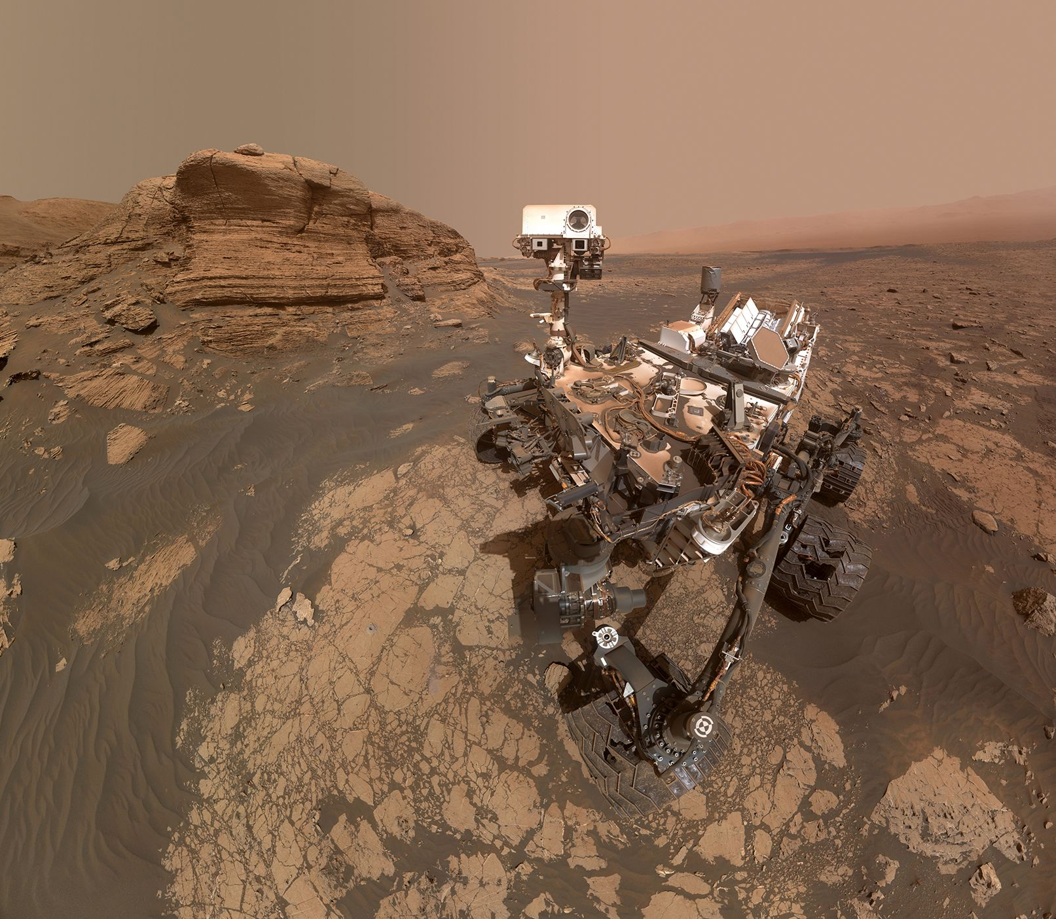
What took this image - Rover, Orbiter or Telescope?
Rover!
But NASA's Curiosity rover needed a second camera to create a selfie of how it looks when it is exploring the surface.
JPL-Caltech/MSSS/NASA

Slide 11
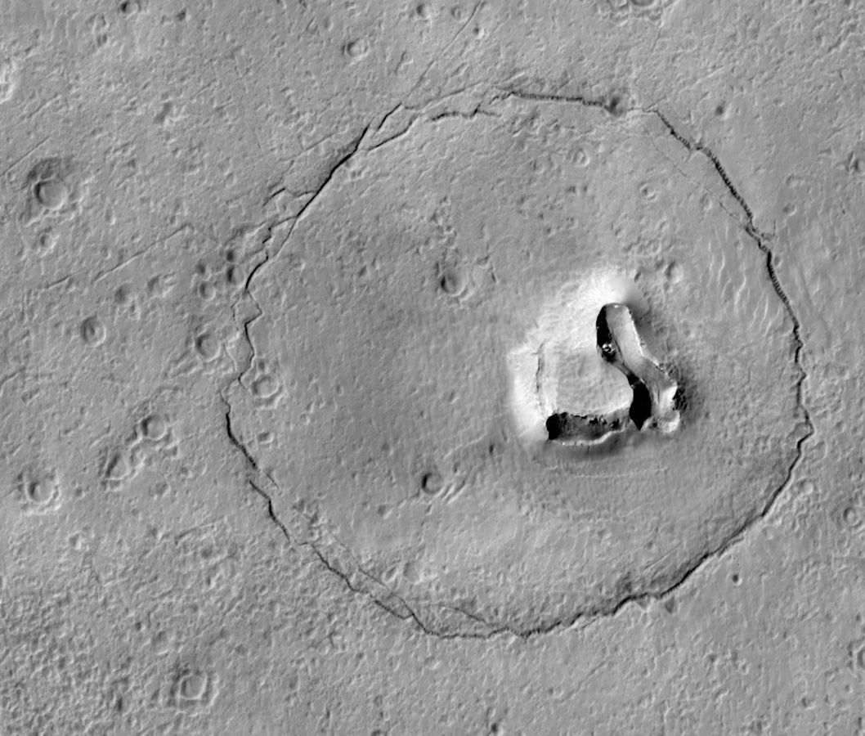
Can you see the bear?
Orbiter Rover or telescope on Earth – what do you think?
This photo was taken by the Mars Reconnaissance Orbiter.
NASA/JPL-Caltech/UArizona

Slide 12
Orbiter, Telescope or Rover?
Telescope!

Slide 13
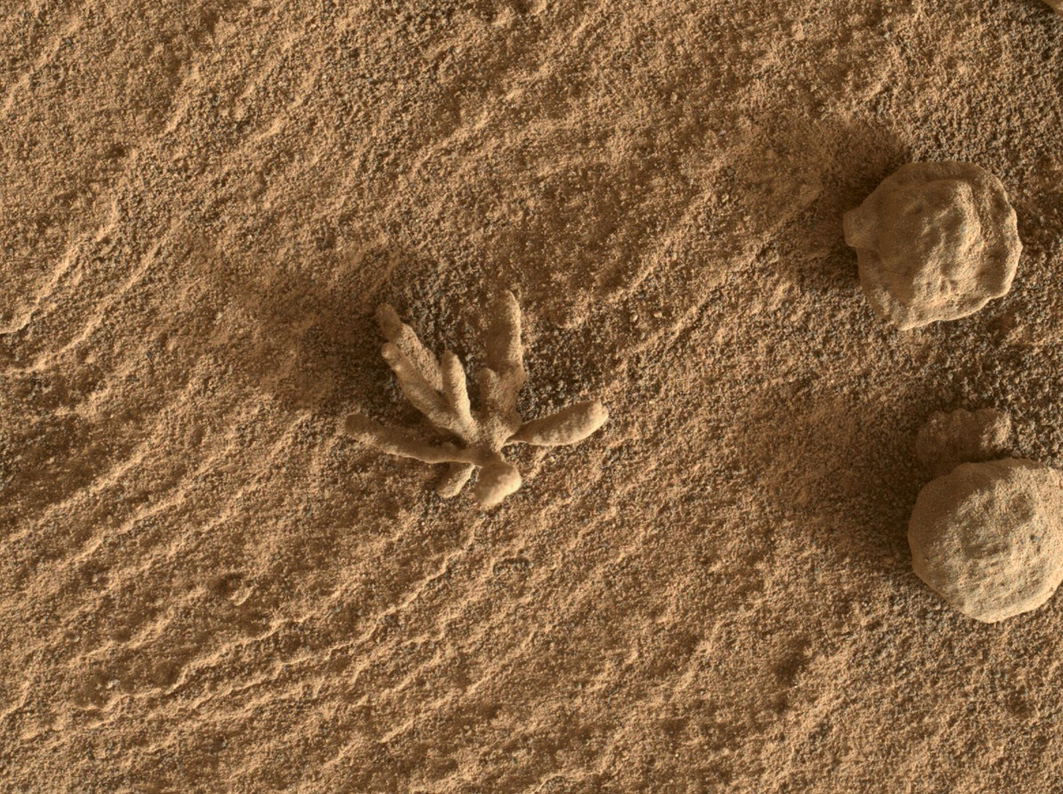
Is this a flower – no it’s a rock formation!
This photo was taken by the Curiosity rover while exploring the Gale Crater. Why is the rock this shape – how did this rocky flower come to be?
Scientists say that billions of years ago, tiny pieces of rock were carried by water and cemented onto the rock.
NASA/JPL-Caltech/MSSS

Slide 14
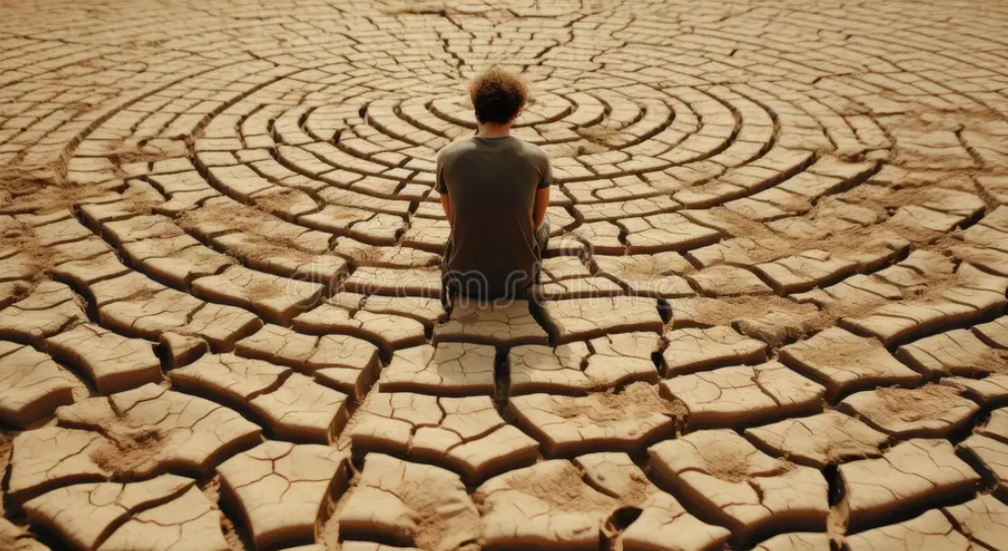
What will it be like – to live on Mars?
We can imagine living on Mars. What will it be like and how can we make it ‘live-able’

Slide 15

Experts working together
A complicated mission or question – like how will we live in Mars – calls for people with different interests and professions to work together

Slide 16
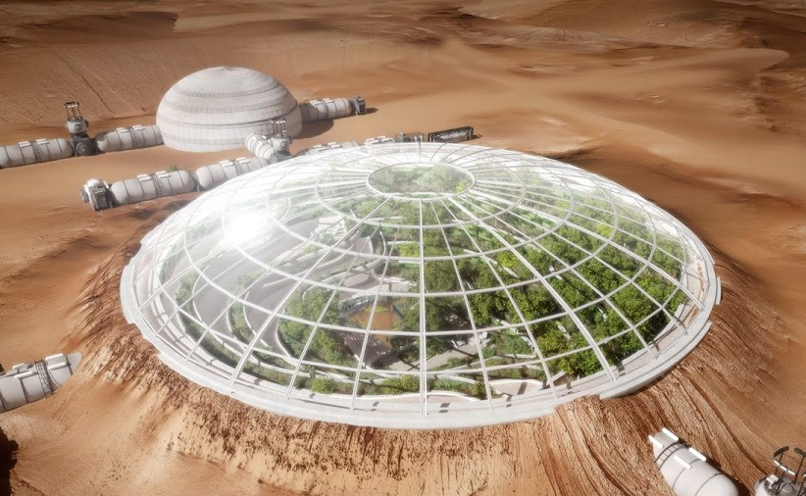
Living on Mars – do we want gardens?
Planning a mission to Mars: Should we take gardeners- why or why not?

Slide 17
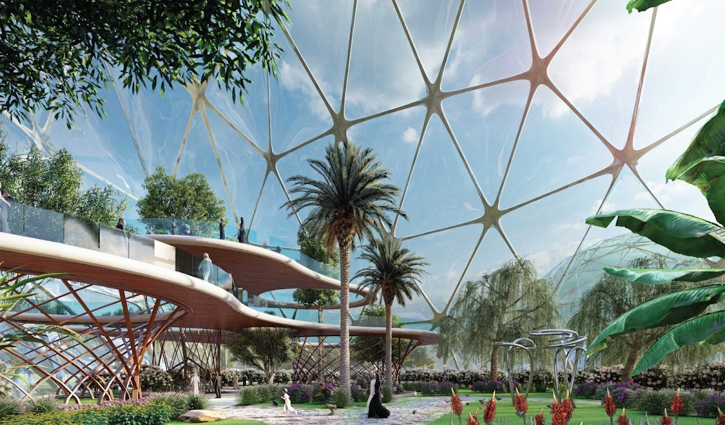
Gardens on earth – in dry places
This garden has been designed for the King Salman Park, Saudi Arabia –a dry, hot country. Perhaps we can copy some ideas
Sources: human Mars: Mars Greenhouse

Slide 18
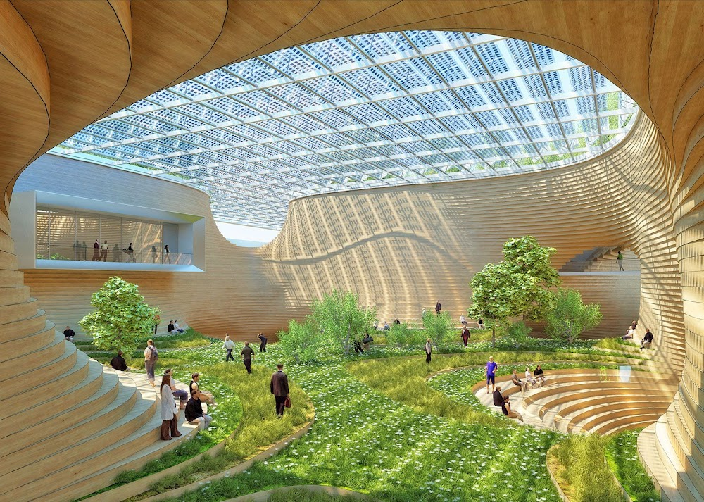
What about a garden – underground?
This image was created by an architect called Vincent Callebaut. His idea is to build a giant garden – underground. What do you think?

Slide 19

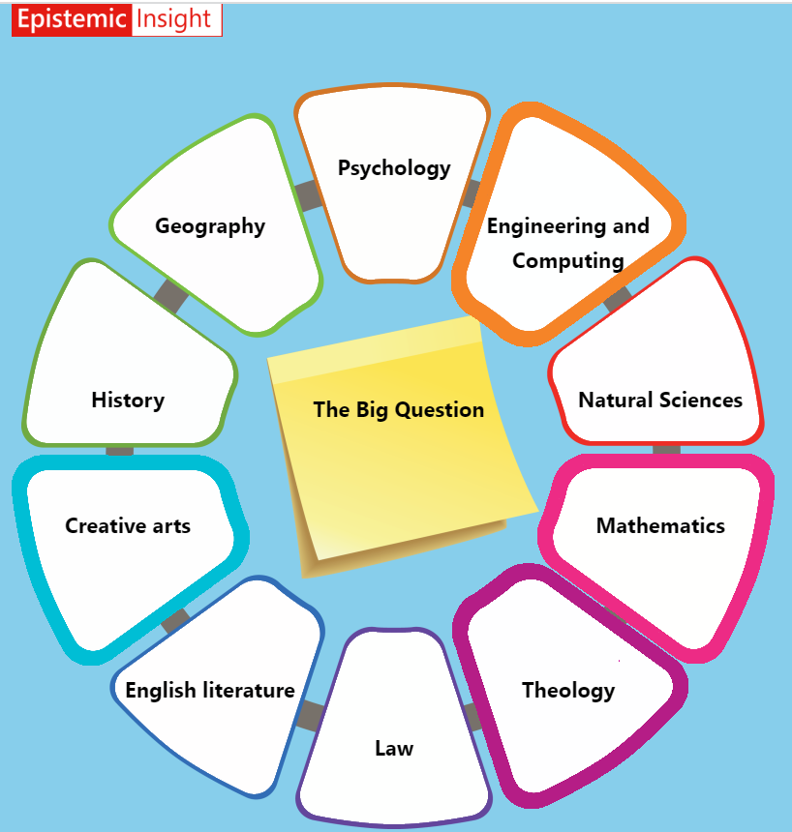
A Discipline Wheel can help you to explore a question through many different subject-disciplines

Slide 20
Conclusion
‘Observation’ is at the heart of science. When we think like a scientists – we are making and talking about observations – to understand the natural world.
Science can answer a question like, Is there liquid water on Mars:
We need many different professions and interests to ‘work together’ to address complex questions – like – can we live on Mars?

